Slide 1
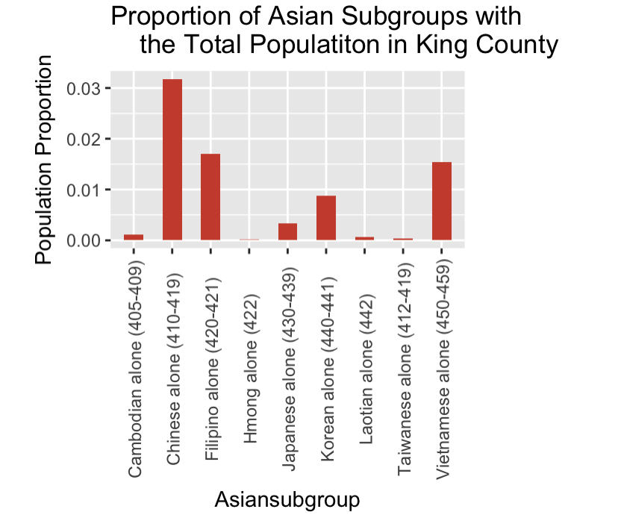
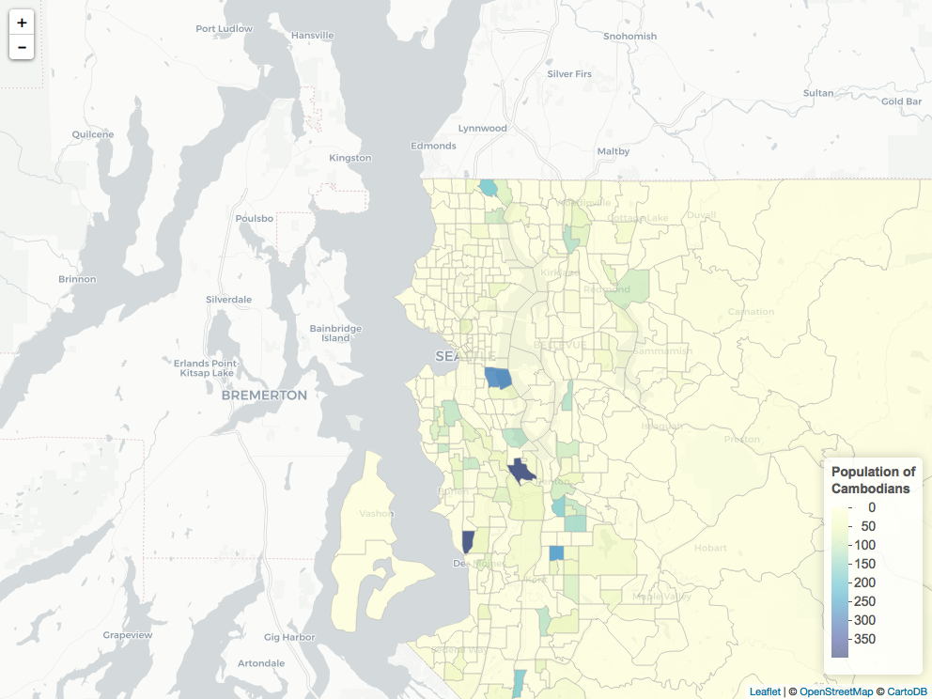
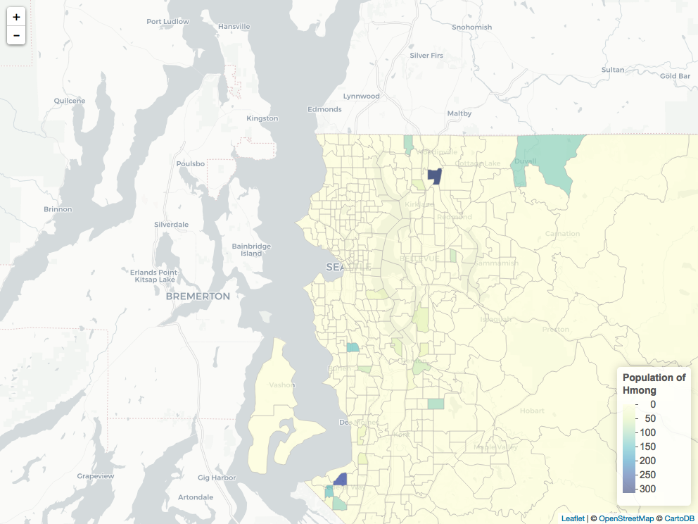
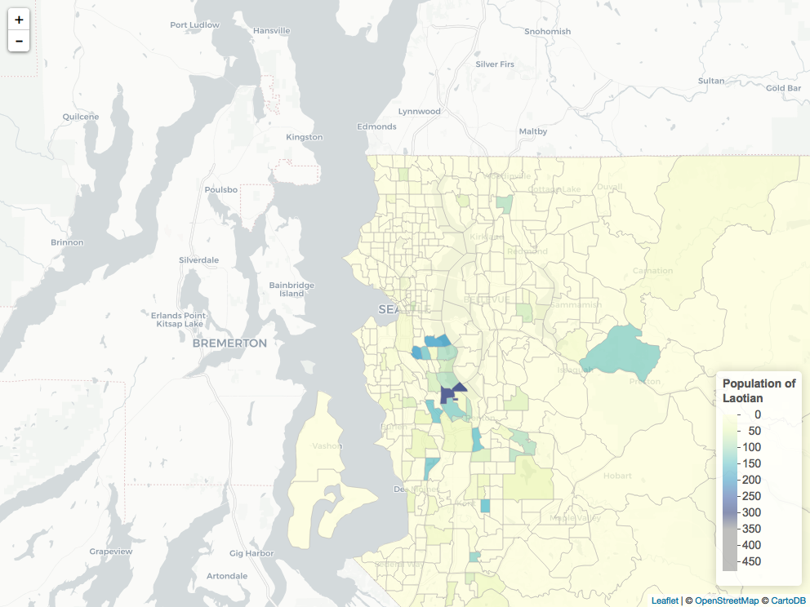
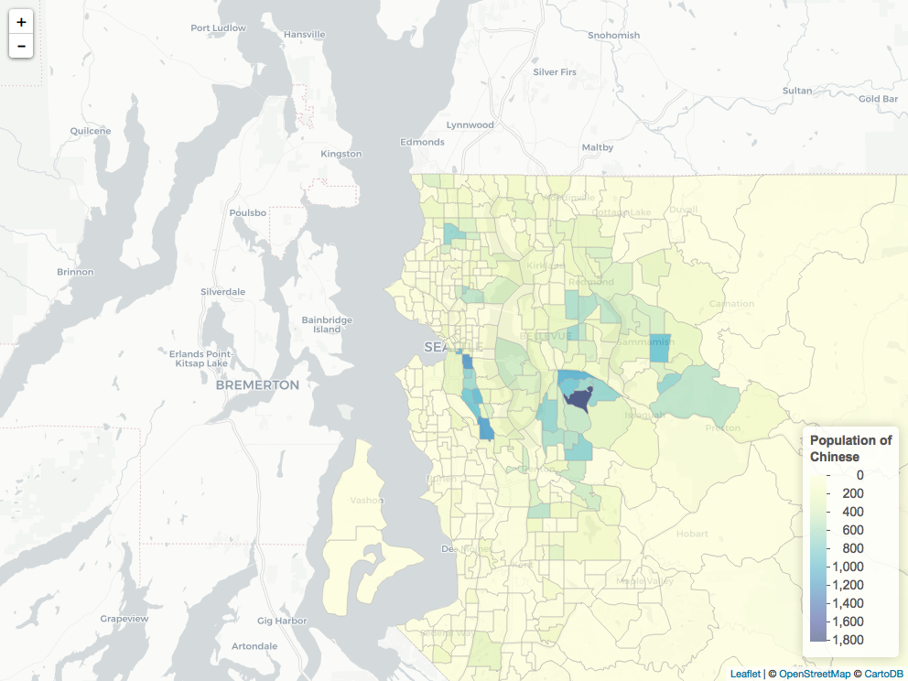
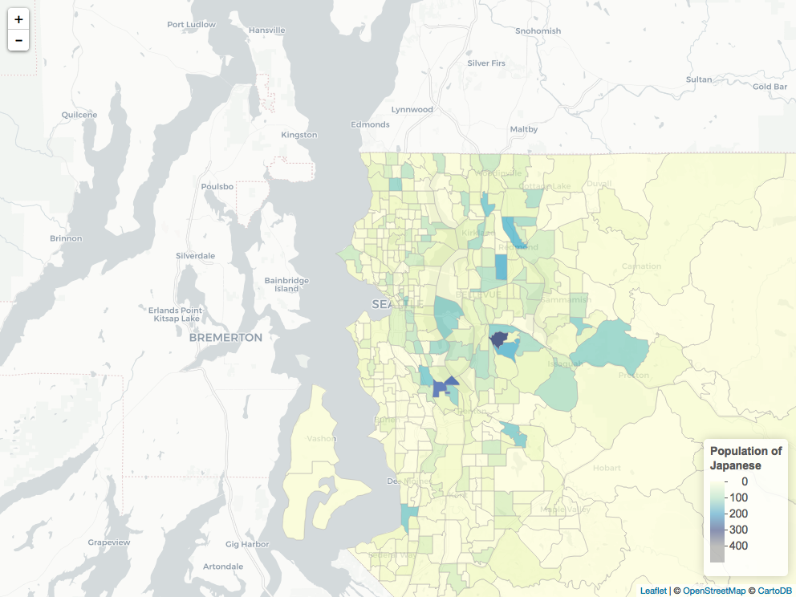
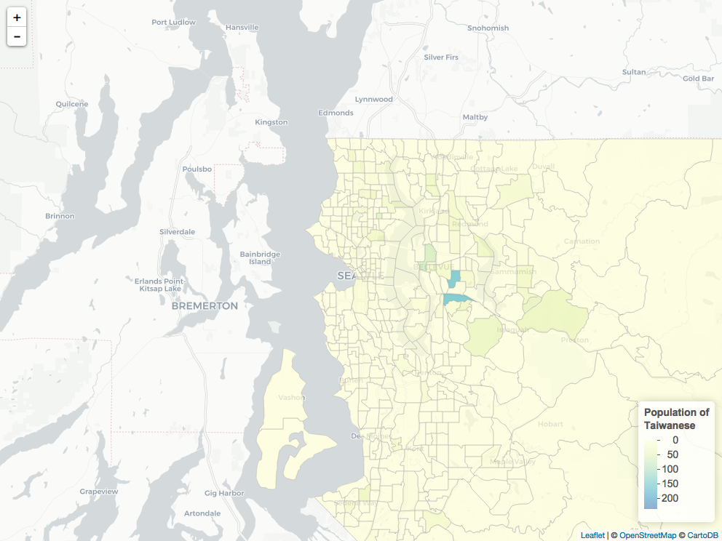
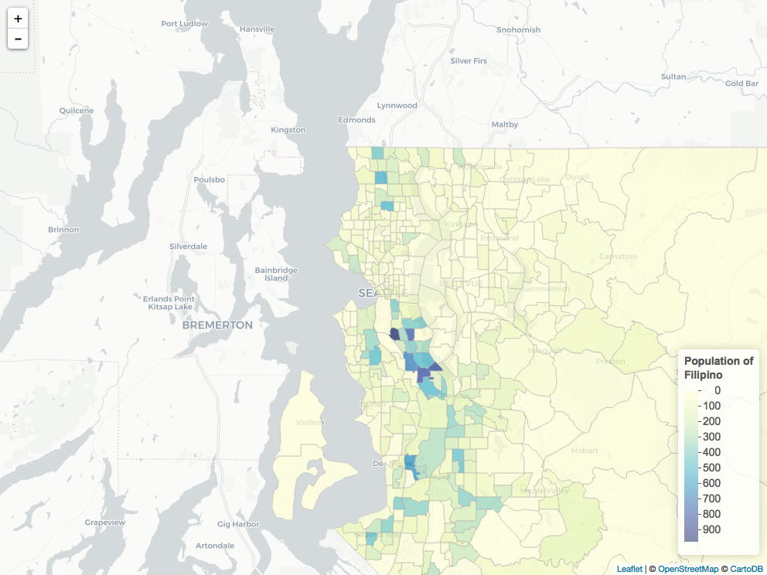
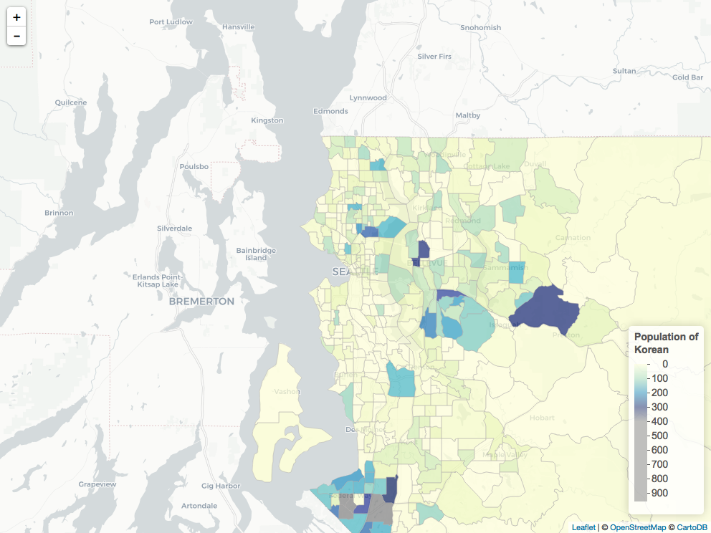
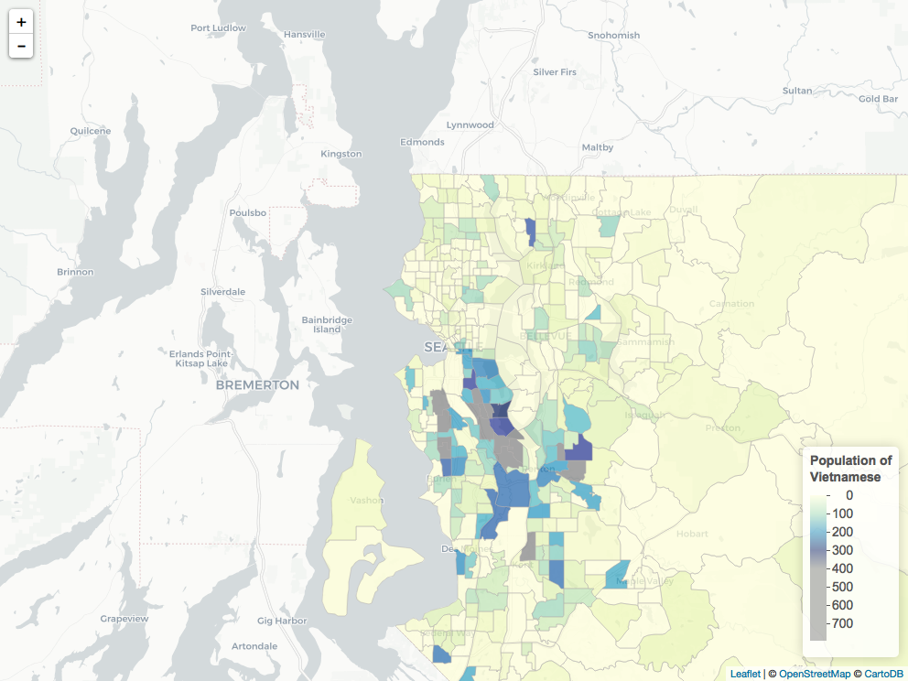
Disaggregated Data on Asian Group in King County
Mara Kage, University of Washington, Department of Sociology Honors Thesis
Statistics 321
Background
Race is an active socially constructed and symbolic categorization based on phenotype or ancestry, deter- mined by historic context and space values.
The Asian American and other communities of color have been historically developed over marginalization and pervasive narratives under the white group dominance - colonialism, slavery, Japanese incarcera- tion. For the AA community, social control has particularly been developed over an aggregated categorization that misrepresented the complexity and diversity of the community and legitimize discourses on race based rhetoric. Since the 1960s, a face value positive discourse on model minority have been deeply impacting the perception of the community. The reality of this myth is that it further masks the deep social challenges of stratification and disparities, benefits a dominant system. It justifying the lack of accountabili- lity and responsibility to the community, sharing of resources, suppress and denies the most marginalized voices and reality by sustaining an aggregated narrati- ve that translates into decisions on programs and policy making.
Research Question
How and what is the magnitude of diversity of the Asian community in King County?
Data and Methods
Datasets were obtained from 2010 Census 5-year Selected Population. 9 Asian subgroups are represented by population count per tract: 1-proportional comparison with the total population in KC, 2-mapped by residential location and density, 3-model on the income effect in the tract by additional Asian subgroup, 4-table on educational attainment of each subgroup.
Screen Shot 2017-12-08 at 4.10.25 PMmmmmmmm
Su Subgroup Spatial Correlation on
Tract Level
Findings
Diversity within the Asian disaggregated category findings reflected the assumptions of wide range of distribution in population size, income and geographical dispersion.
Further Questions and Research
Under the theme of “feeling race” and Eduardo Bonilla-Silva’s colorblind racism framework, I am looking forward to carry interviews, test and capture a glimpse of the negotiations of identity and intersectionality of the Asian American experience. I will seek respondents that self identify as Asian American female artists, LGBT and heterosexual, and understand their experience into the insertion to the mainstream art world in Seattle. How does the contrast of their identity and aspects of the framework (Abstract Liberalism, Naturalism, Cultural Racism and Minimization of Racism ) is challenged, encouraged or empowered in this perceived liberal, and yet restricted accessed world.
Maps of Asian Subgroup Population on Tract Level
Reference and Acknowledgements
2010 ACS 5-year Selected Population https://factfinder.census.gov/faces/nav/jsf/pages/index.xhtml
Code for maps adapted from Sean Wang's "Spatial analysis with `tigris` and `acs`" provided by Victoria Sass.
*The Hidden Academic Opportunity Gaps Among Asian Americans and Pacific Islanders: What Disaggregated Data Reveals in Washington State
Notes:
1

